Slide 1
DIGITAL PORTFOLIO
STUDENT NAME: TULASI PRIYA G
REGISTER NO AND NMID:2428B0361 D311BAB6870ACED8C344D54BFA7A2E57
DEPARTMENT: D311BAB6870ACED8C344D54BFA7A2E57
COLLEGE:COLLEGE:KPR COLLEGE OF ARTS SCIENCE AND RESEARCH
UNIVERSITY:BARATHIYAR UNIVERSITY

Slide 2
PROJECT TITLE ONLINE COURSES COMPLETED

Slide 3


AGENDA
Problem Statement
Project Overview
End Users
Tools and Technologies
Portfolio design and Layout
Features and Functionality
Results and Screenshots
Conclusion
Github Link
3/21/2024 Annual Review

Slide 4

PROBLEM STATEMENT
In today’s competitive academic and professional environment, students and learners often complete multiple online courses across different platforms such as Coursera, Udemy, edX, and LinkedIn Learning. However, there is no simple, organized way to showcase these achievements in a structured format within a digital portfolio or resume. This creates a challenge for learners to highlight their acquired skills effectively, and for recruiters or educators to verify and evaluate these accomplishments.
Therefore, there is a need for a dedicated section in a portfolio/resume that presents “Online Courses Completed” in a visually appealing and structured manner, making it easy for employers, professors, or peers to quickly identify the learner’s skill set, certifications, and areas of interest.

Slide 5

PROJECT OVERVIEW
The project “Online Courses Completed” aims to design and develop a digital portfolio feature that allows students and professionals to systematically showcase the online certifications and courses they have completed. With the rapid growth of e-learning platforms, individuals often accumulate a wide range of certifications, but these achievements remain scattered across different sites and certificates. This project provides a centralized platform where all such courses can be displayed in an organized, attractive, and verifiable format.
The portfolio will include details such as course title, platform, completion date, issuing organization, and relevant skills acquired. The design will focus on simplicity, clarity, and professionalism to ensure that recruiters, educators, or peers can easily assess the learner’s expertise. By integrating this feature into a personal portfolio or resume website, learners will have a credible and visually engaging way to demonstrate their continuous learning efforts and specialized knowledge.
The project not only helps in bridging the gap between online learning and professional recognition but also promotes the value of self-paced education and lifelong learning.

Slide 6

WHO ARE THE END USERS?
Students
To showcase the online certifications they have completed along with academic qualifications.
Helps during placements, internships, or higher studies applications.
Job Seekers / Professionals
To present their continuous learning and skill development in their resumes or digital portfolios.
Useful for career shifts or promotions.
Recruiters / Employers
To quickly verify and evaluate a candidate’s relevant skills and certifications.
Makes shortlisting easier during hiring processes.
Educators / Mentors
To monitor their students’ progress in online learning.
Encourages learners to take up additional certified courses.
Institutions / Training Centers
Can use the portfolio system to validate and showcase students’ skill sets.
Helps in college placement drives.

Slide 7

TOOLS AND TECHNIQUES
HTML5, CSS3, JavaScript – To build and style the “Online Courses Completed” section with interactive features.
VS Code – As the main development environment.
Git & GitHub – For version control and portfolio hosting.
Responsive Web Design (RWD) – To ensure the portfolio looks good on all devices.
User-Centered Design – Keeping the layout simple, professional, and recruiter-friendly.
(Optional) Bootstrap / Tailwind CSS – For faster and modern styling.

Slide 8
POTFOLIO DESIGN AND LAYOUT
The portfolio is designed with a clean, structured, and professional layout to highlight the completed online courses. The section is arranged in a card or list format for easy readability.
Each course entry contains the following details:
Course Title (e.g., Introduction to Data Analytics)
Platform / Provider (Coursera, Udemy, edX, etc.)
Completion Date
Skills Acquired / Key Learnings
Certificate Link (if available)
Layout Features:
Header Section – Title “Online Courses Completed” with a simple icon.
Grid or Card View – Courses displayed in visually appealing cards or a timeline layout.
Responsive Design – Adjusts seamlessly for mobile, tablet, and desktop screens.
Consistent Theme – Professional fonts, matching colors, and subtle hover effects for interactivity.
This design ensures that the portfolio remains clear, recruiter-friendly, and easy to navigate, making the learner’s skills and certifications stand out effectively.
8

Slide 9
FEATURES AND FUNCTIONALITY
Course Display – Shows course title, platform, completion date, and skills gained.
Certificate Linking – Option to attach/view the certificate for verification.
Responsive Layout – Works smoothly on mobile, tablet, and desktop.
Interactive Design – Hover effects, clickable links, or expandable course details.
Search/Filter Option (optional) – Allows quick filtering of courses by platform or skill.
User-Friendly Interface – Clean, professional, and recruiter-focused design

Slide 10

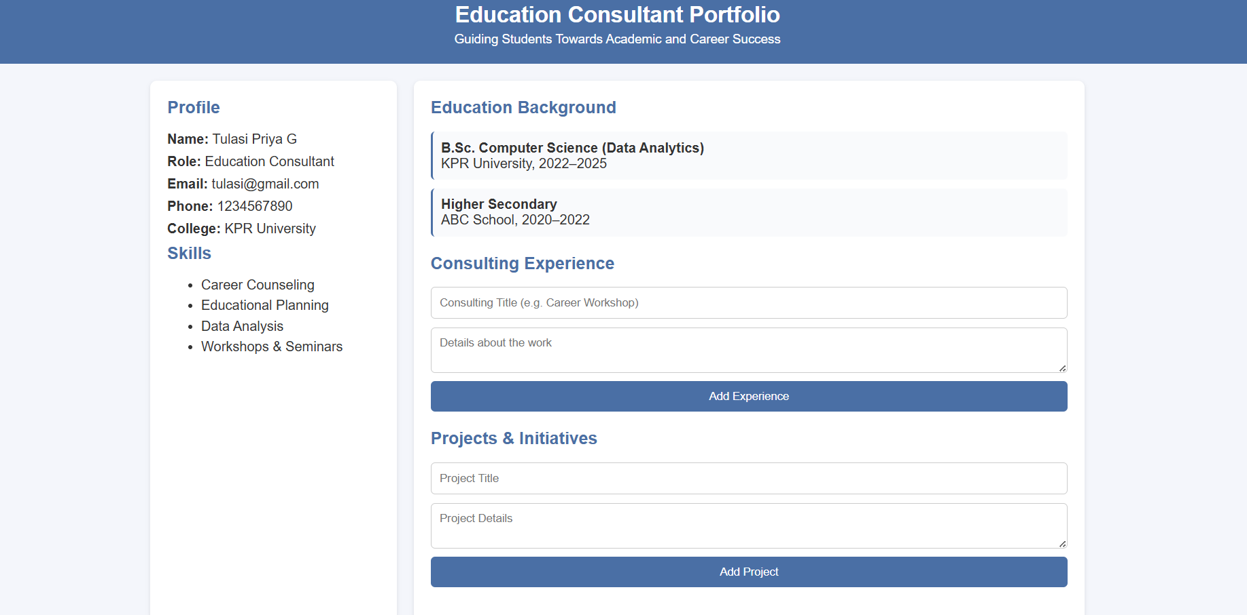
RESULTS AND SCREENSHOTS
Results: The project successfully created a professional “Online Courses Completed” section in the portfolio. It allows students and professionals to showcase their online certifications in an organized and visually appealing manner. The design is responsive, user-friendly, and provides recruiters or mentors with quick access to course details and certificate links. This improves the overall credibility and attractiveness of the portfolio.
3/21/2024 Annual Review
10

Slide 11
CONCLUSION
The project “Online Courses Completed” successfully demonstrates how online learning achievements can be showcased in a professional and organized way within a digital portfolio. By using simple web technologies like HTML, CSS, and JavaScript, the section provides a clean layout to display course details, skills gained, and certificate links. The responsive design ensures accessibility across devices, making it useful for students, professionals, and recruiters alike.
This project highlights the importance of continuous learning and provides a platform where achievements are not only stored but also presented in a visually appealing and recruiter-friendly format. It bridges the gap between online education and professional recognition, supporting both career growth and academic opportunities.
11

Slide 12
GITHUB LINK
https://tulasip682-wq.github.io/portfolio-tulasi/

